Slide 1
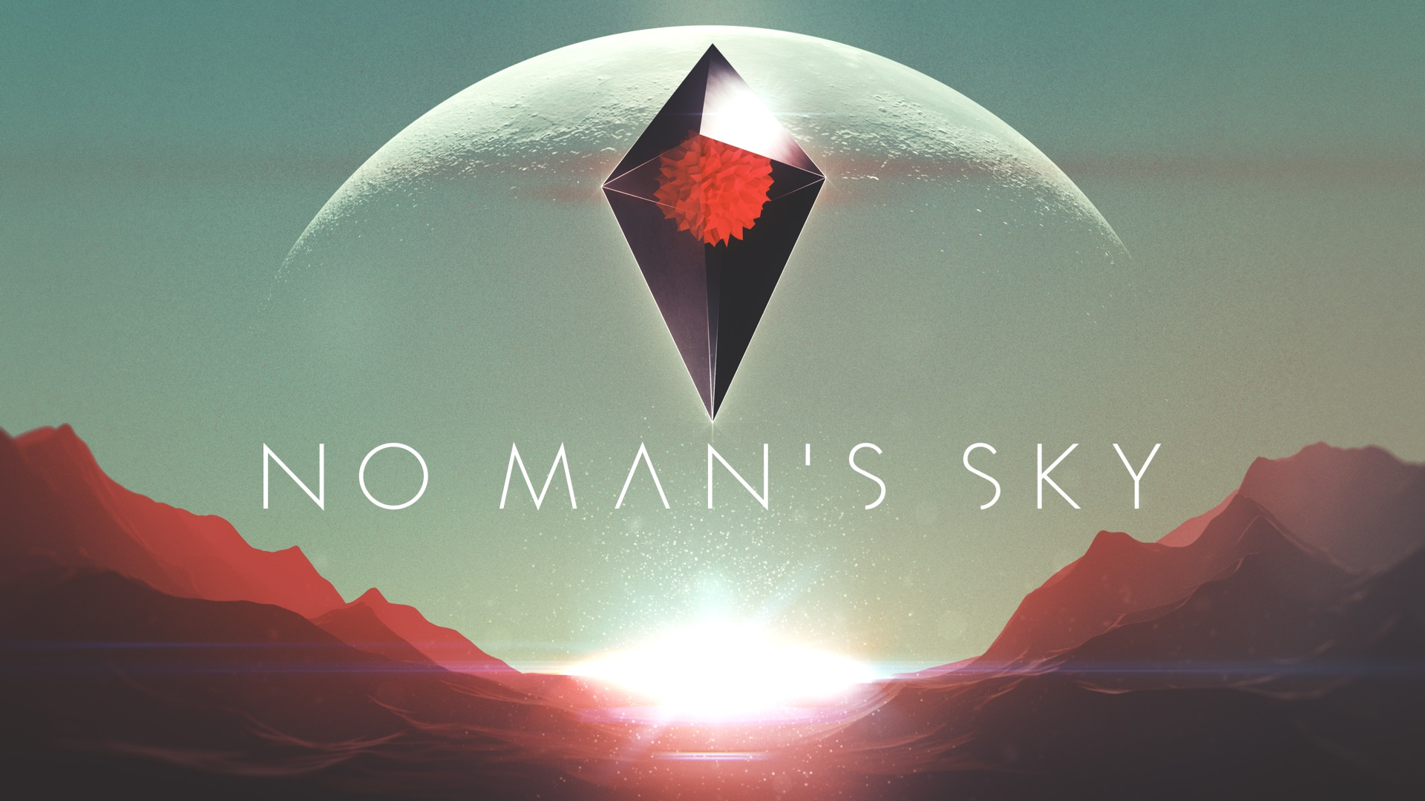
A Presentation By Ryan Lebeau
03-60-377

Slide 2
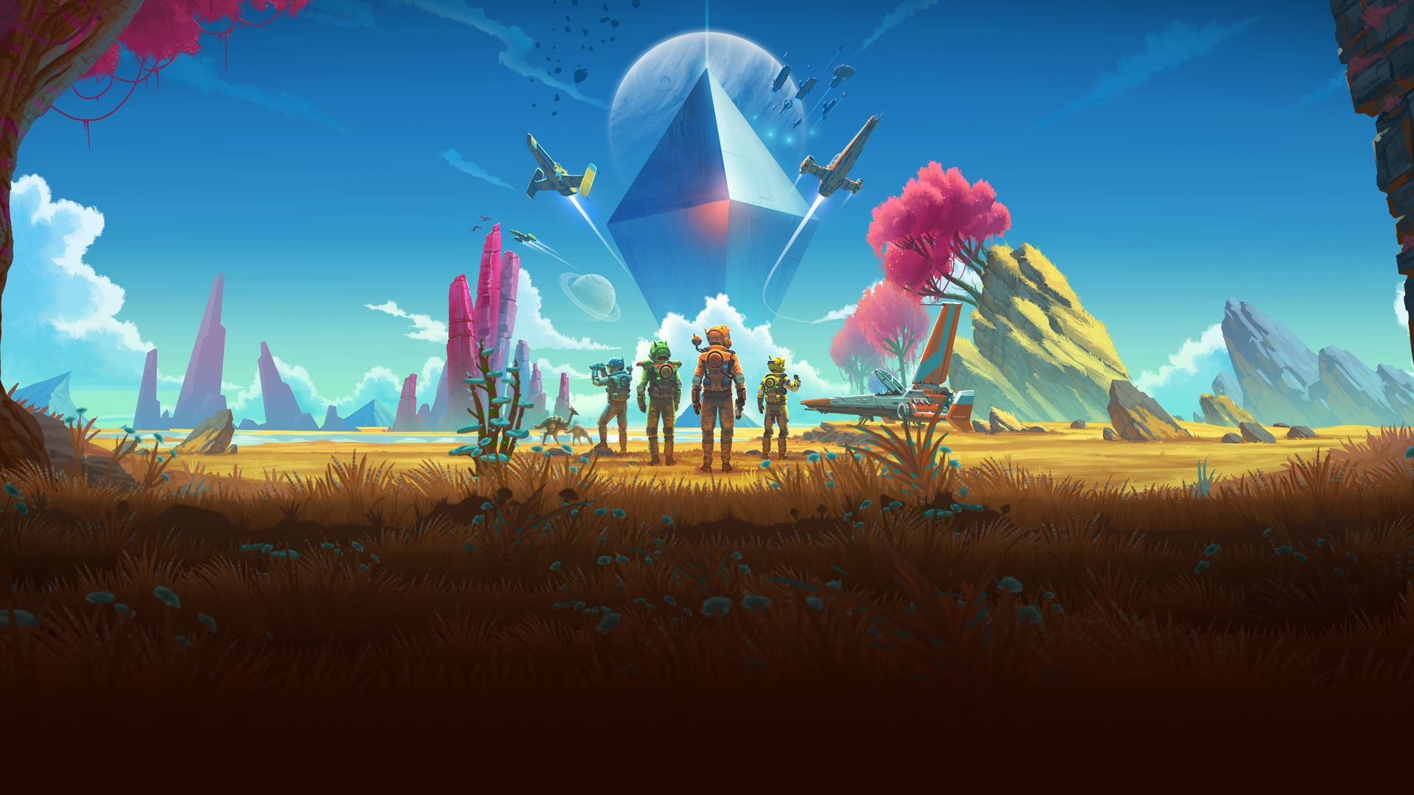

What is No Man’s Sky?
Procedurally generated space exploration game
Game starts the player on a random planet
Slowly progress to new dynamic star systems
Main story goal is to the center of the universe

Slide 3
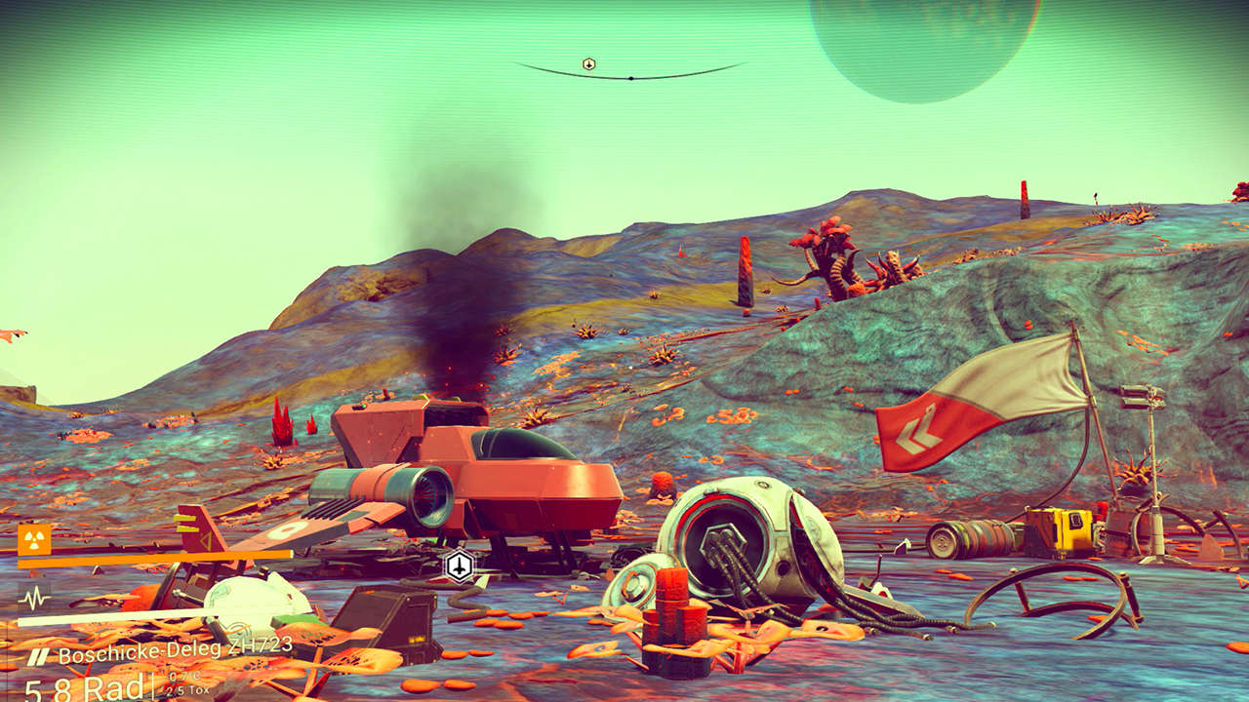
The Beginning
Random world
Classic video game memory loss
Quickly fix broken equipment
Story line begins

Slide 4
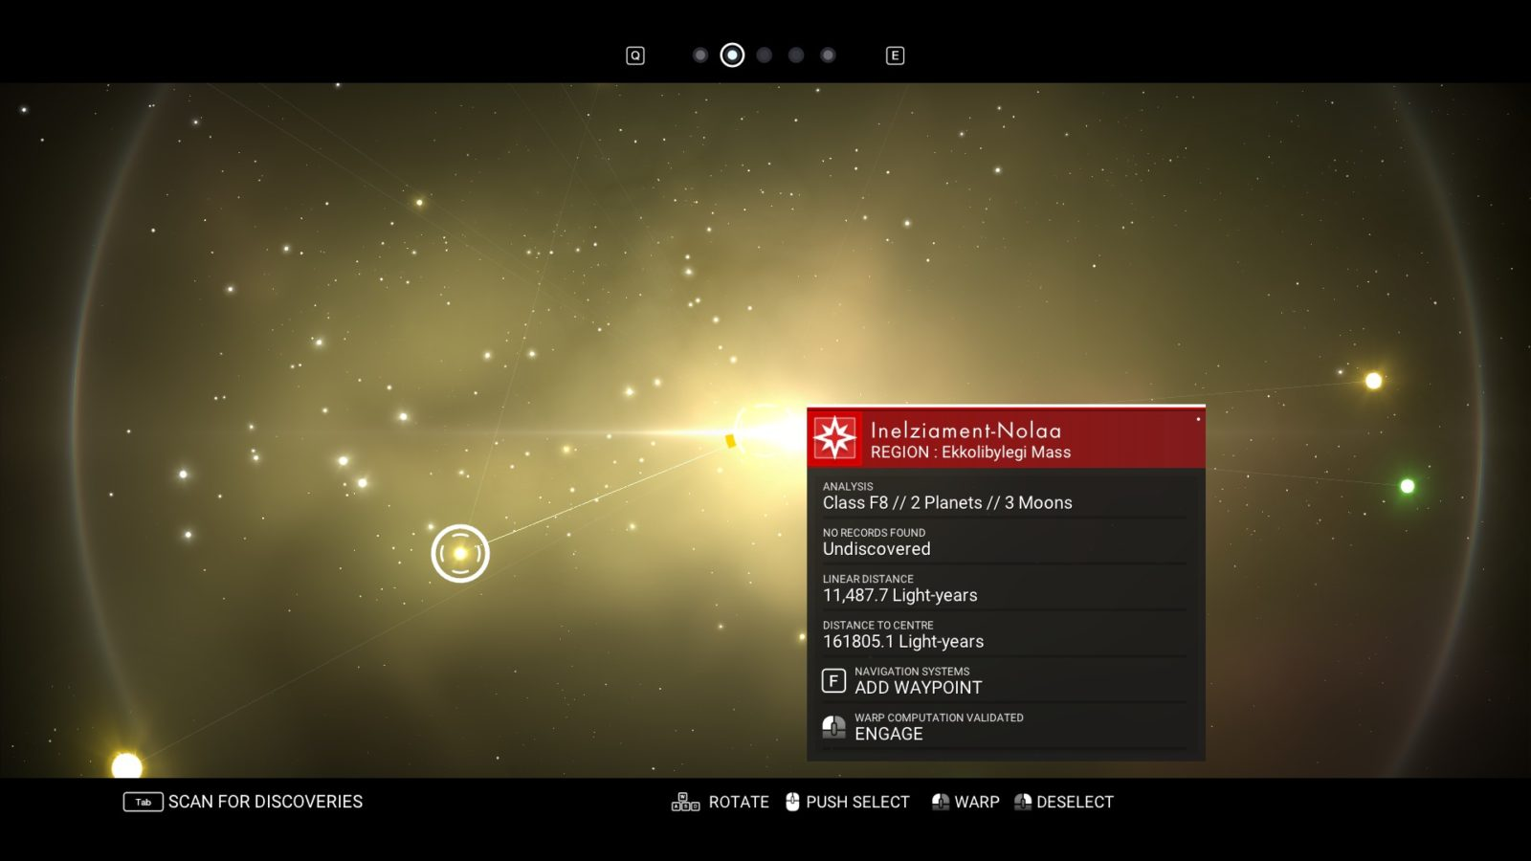
Space
Warp between star systems each with varying planets/moons
Fly throughout the star system
Engage in space battles

Slide 5
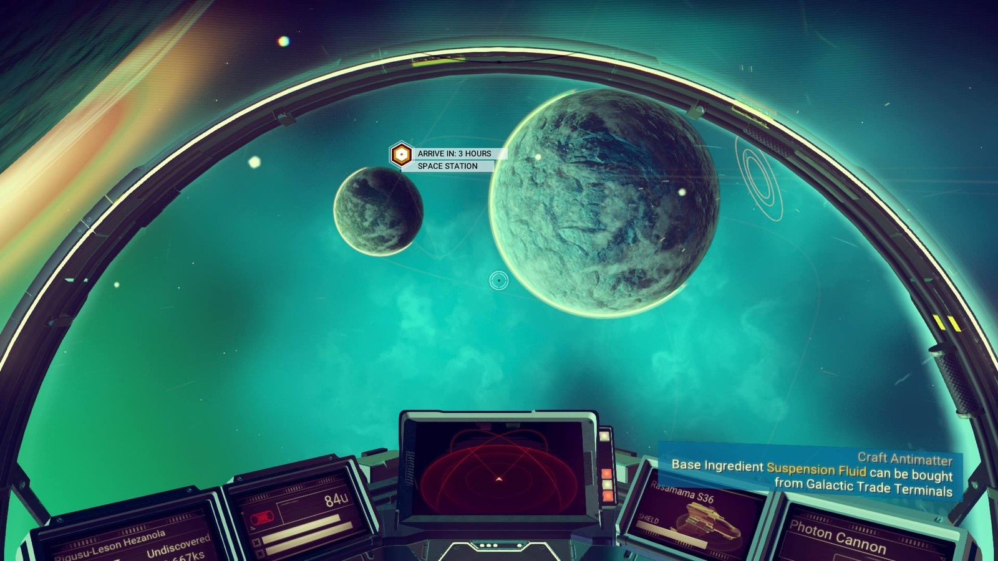

Slide 6
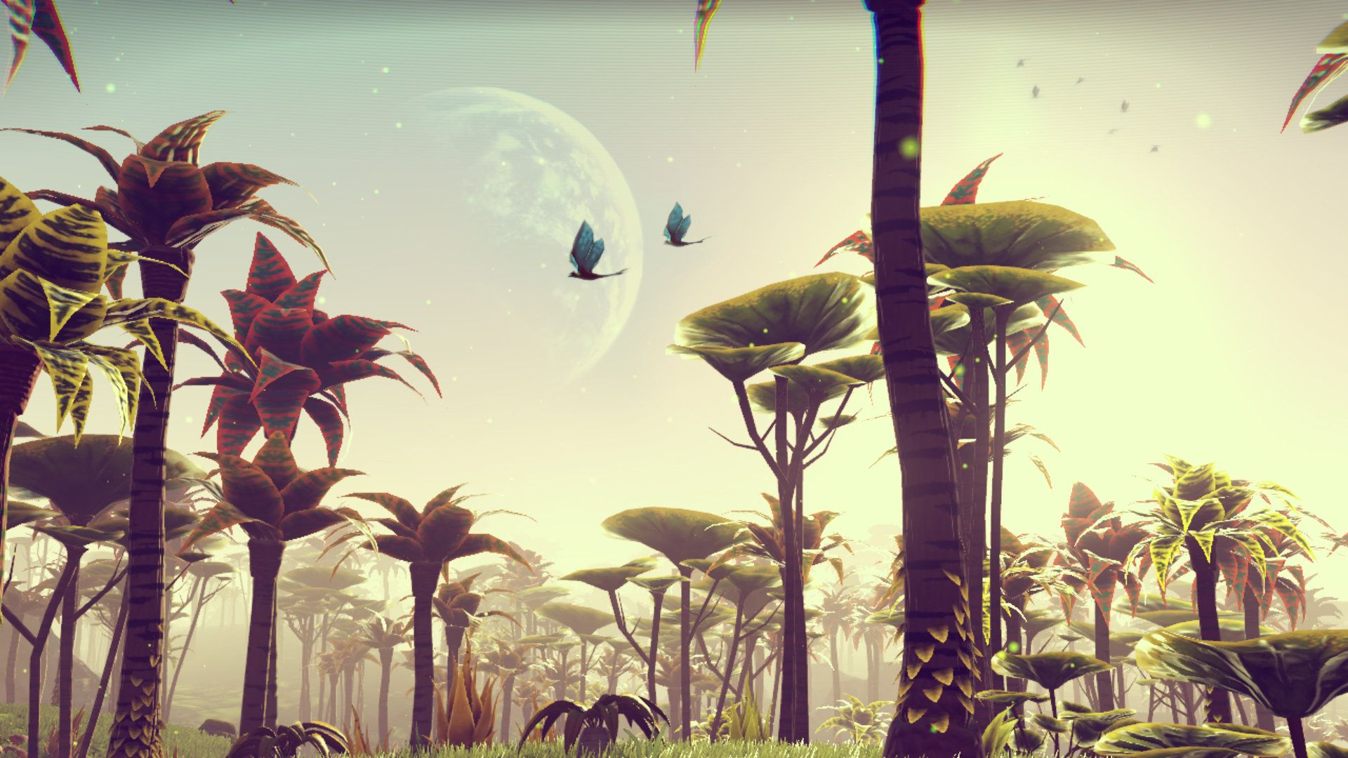
Planets
Each planet is free roam
Every planet has it’s own features
Fauna, Flora, Resources
Atmosphere, Weather Systems
Random Structures
There are different colour schemes for the planets

Slide 7
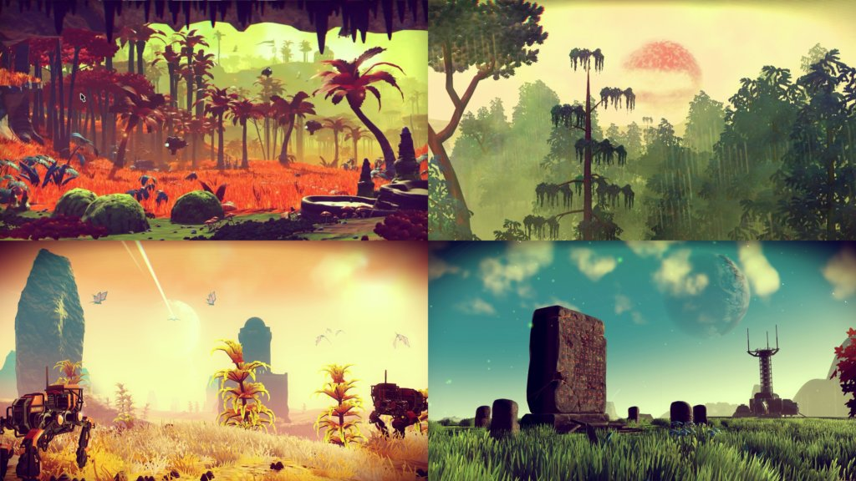

Slide 8
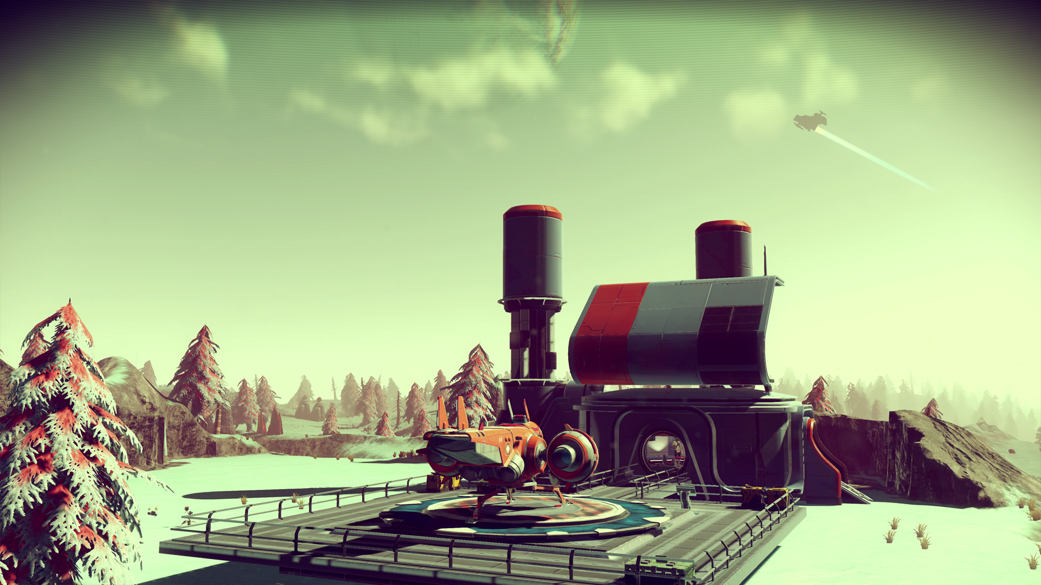
Random Structures
Located through player’s personal scanner or the craftable Signal Booster
Certain structures are multi-tier
Some Structures include
Observatory
Abandoned factories
Trading Post
Monolith
Crashed Freighters

Slide 9
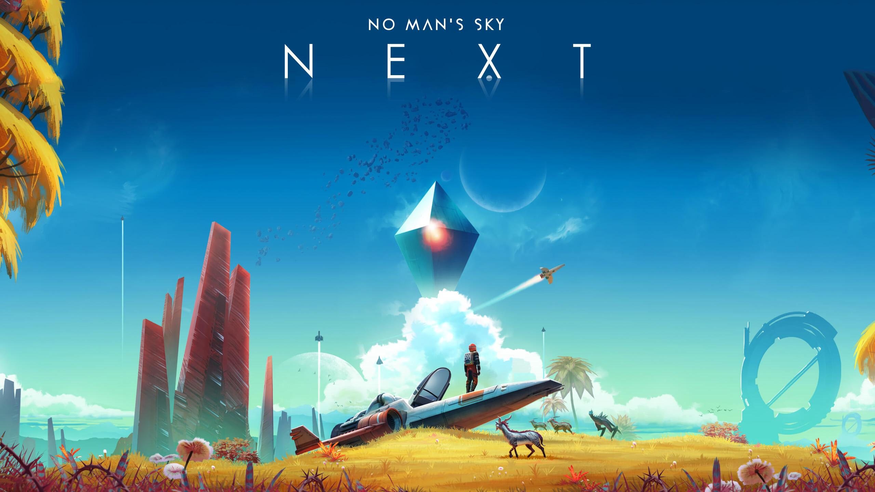
The launch in 2016 was understandably hyped considering it was one of the first in its class
Extreme backlash from the community since promised features were completely missing (mainly multiplayer)
Last month was the games largest update, NEXT, bringing many promised features and large amounts of content
Team is continually putting out updates with promises for no DLC content

Slide 10
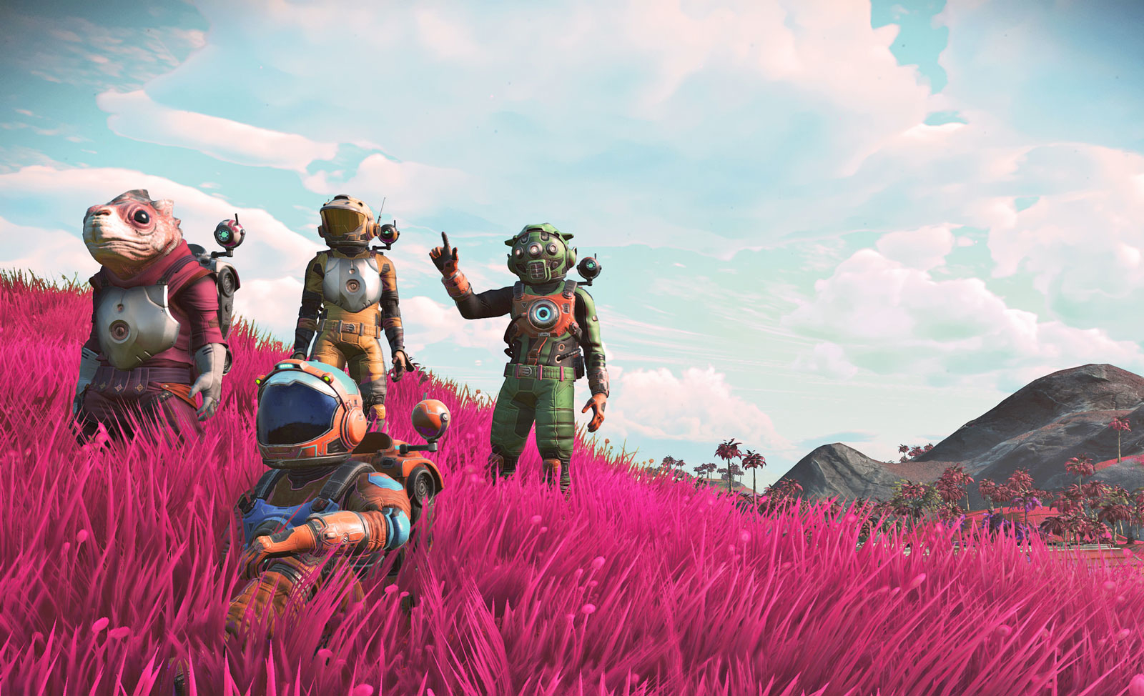
Multiplayer
Two options for players
Single player
Party multiplayer
P2P trading
Story can be continued and completed with a party
Multiplayer bases

Slide 11
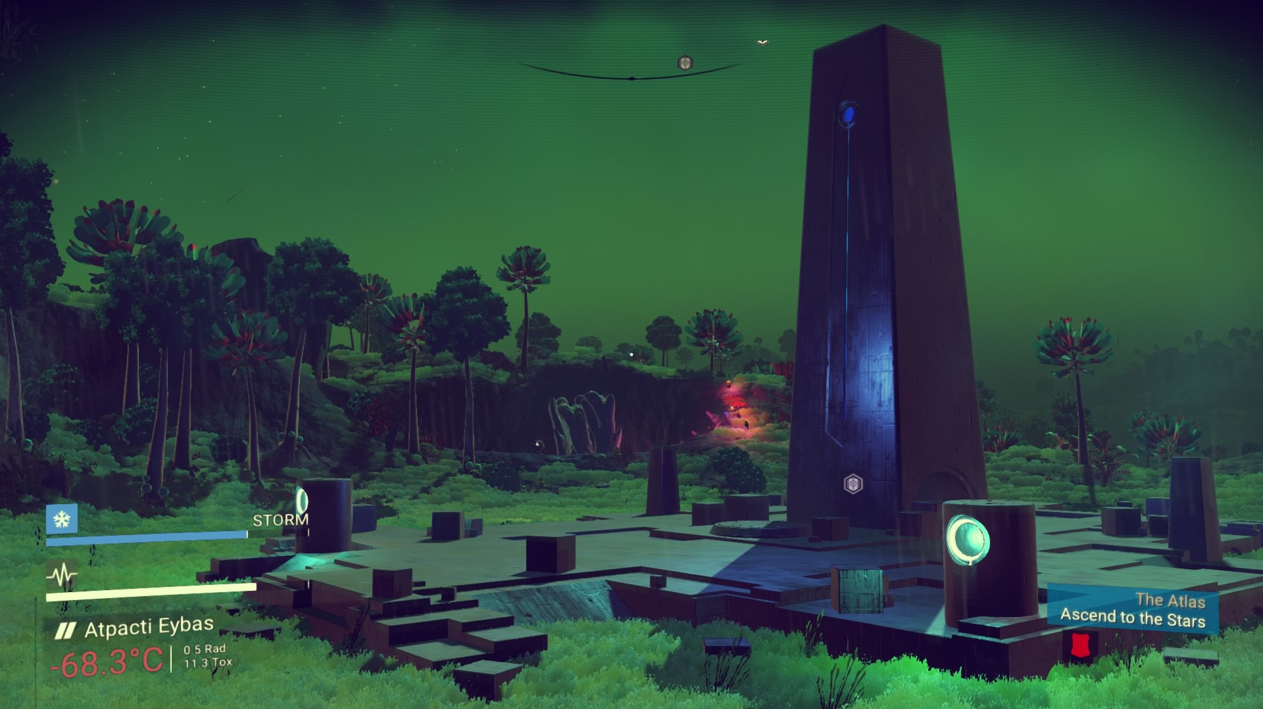
Story
The universe is seemingly controlled by The Atlas
Each story mission helps you learn more
Interactions with other NPC’s of the three races (Gek, Vy’keen, Korvax) provide details of the past
The story line concludes at the Atlas Centre

Slide 12
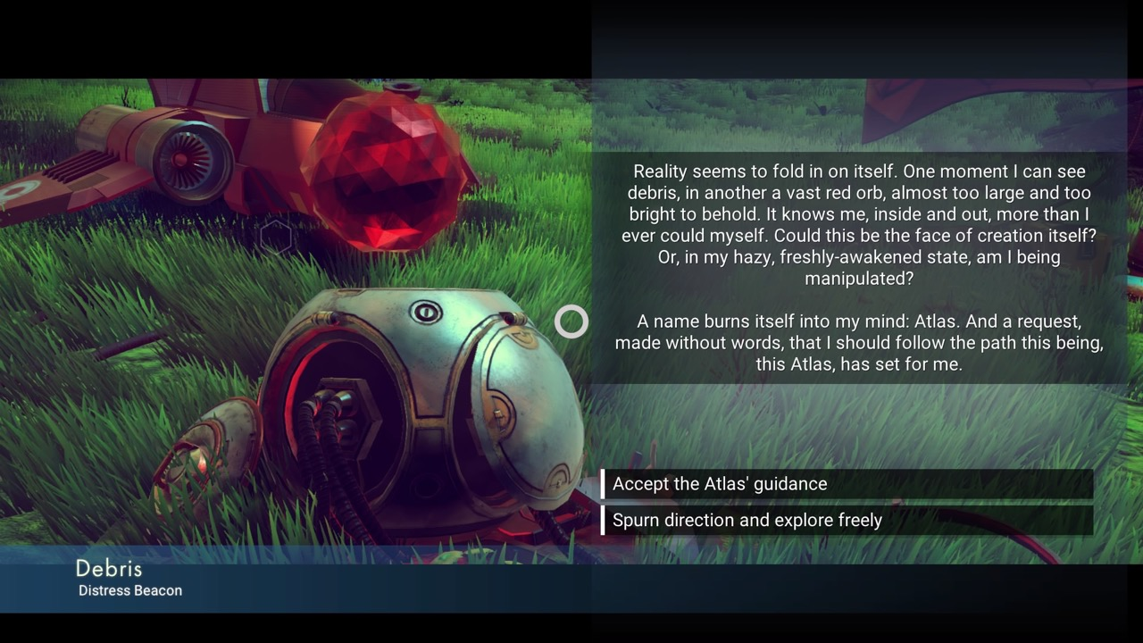

Slide 13
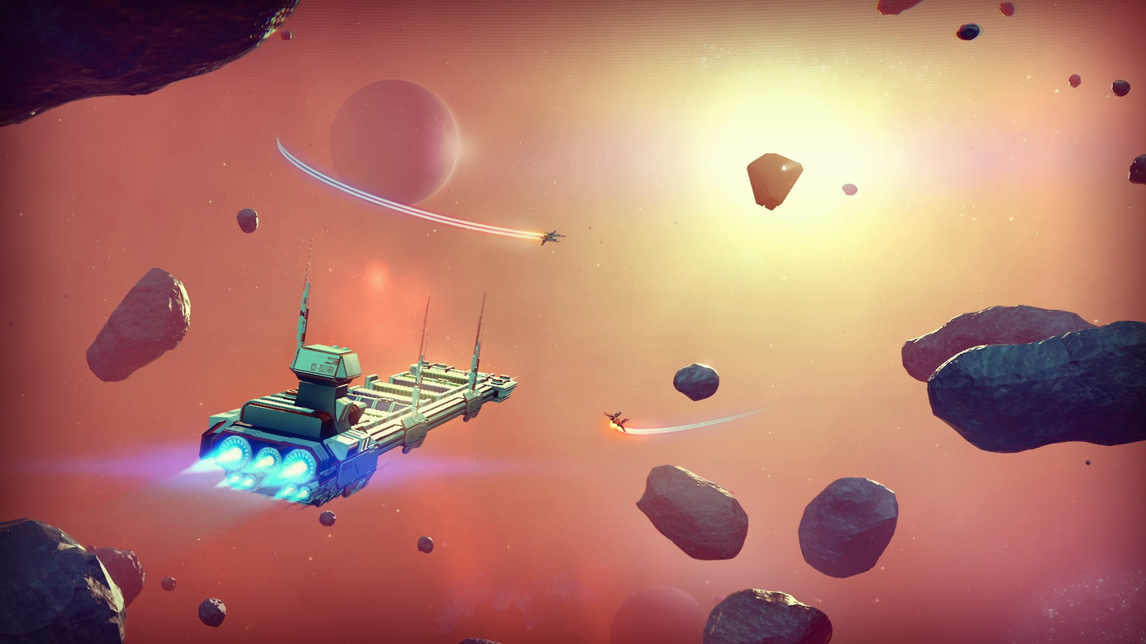
General Features
Blueprints
Crafting Items
Mining
Standing amongst three NPC races
Freighters
Bounty Hunting

Slide 14
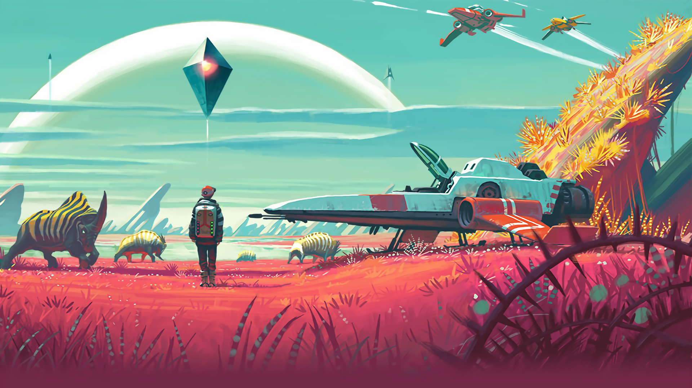
Schell’s Lenses
Surprise – Lens 4
Planets are filled with surprises
Curiosity – Lens 6
Story line asks the player non stop questions
Endless universe
Economy – Lens 52
Units and nanite clusters
Galactic trade network
Story Machine – Lens 73
Community events
Playing in a party within constantly new worlds
The World – Lens 84
Infinite star systems with 4-6 planets
Constantly entices the player to explore

